Slide 1

UMT Portfolio Manager 3.3 Server
Architecture & Project Server Gateway Overview
Ben Chamberlain
Senior Product Manager
Microsoft Project
Toll-Free #: 1 866 836 9489
Toll #: 1 517 233 5764
Code: 3667371
In partnership with
In partnership with

Slide 2

Agenda
Selling UMT Portfolio Manager: Rules of Engagement
PPS 2006 and 2007 Release Overview
Architectural Overview
  System Requirements
  Physical & Logical Architecture
  PPM & APM Process Overview
  Configuration Options
  Reporting
  Security, Extensibility & Interoperability
Project Server Gateway Overview
  Configuration
  Data Flow / Transfer
  Demonstration
Readiness Update
Q & A

Slide 3
UMT Portfolio Manager 3.3 Server
How to sell the UMT Portfolio Manager 3.3 Server
How and when to work with UMT Consulting Group

Slide 4
Sales and Deployment Roles & Responsibilities
Pre-Sales
Proof of Concept
Full Deployment
Support
Return contracts
to Microsoft
Corporate to
be countersigned
Return contracts
to Microsoft
Corporate to
be countersigned
EPM SSP
Complete 90 Day
Evaluation License
Complete License
& Support Contracts
UMT CG
Product
Support
(Tier 1 & 2)
Sales Lead / RFP or RFI
Deploy Solution
Pre-Sales Activities
Bits Fulfillment
Run Proof
of Concept
End User
Training
EPM Partner
Run Proof
of Concept
Deploy Solution

Slide 5
Working with UMT Consulting Group
UMT Consulting Group’s relationship with Microsoft defined:
  UMT Consulting Group are a valuable addition to the EPM Partner network
  UMT Consulting Group are acting as a Software Provider for a period of one year
  UMT Consulting Group are acting as a Service Provider for a period of one year
Pre-Sales
  UMT Consulting Group are acting as a Software Provider for a period of one year from the acquisition date. This empowers them to sell the UMT Portfolio Manager 3.3 Server on Microsoft’s behalf.
  EPM SSPs and EPM Partners can choose to engage UMT Consulting Group to support pre-sales efforts.
License & Support Contracts
  Contracts are established between Microsoft and the customer
  UMT Consulting Group and / or EPM SSPs are responsible for ensuring the appropriate contracts are signed by the customer before starting a Proof of Concept of Full deployment.
  EPM Partners can work directly with the EPM SSPs to complete all necessary evaluation, license and support contracts (note: Partners do not have to work through UMT Consulting Group)
UMT Portfolio Manager 3.3 Server Bits Fulfillment
  As a Service Provider, UMT Consulting Group are authorized to distribute the UMT Portfolio Manager 3.3 Server Bits on Microsoft’s behalf.
  EPM SSPs and EPM Partners should contact UMT Consulting Group (wrowland@umt.com) to gain access to the UMT Portfolio Manager 3.3 Server download site.
Implementation / Deployment Services
  EPM SSPs can choose to work with UMT Consulting Group or other EPM Partners to deploy the solution. (Note: UMT Consulting Group do not have to provide the deployment services)
  EPM Partners should contact UMT Consulting Group to understand how they can take advantage of their training, support and implementation services.
Product Support
  As a Service Provider, UMT Consulting Group will provide Tier 1 and Tier 2 product support for customers that purchase UMT Portfolio Manager 3.3 Server. (Note: Tier 3 support provided by Microsoft)

Slide 6
UMT Integration Release Schedule
3 Phase Release Schedule
UMT Portfolio Manager 3.3 Server
Microsoft Office Project Portfolio Server 2006
Microsoft Office Project Portfolio Server 2007

Slide 7
3 Phase Release Roadmap
Jan 06
Feb 06
Mar 06
Apr 06
May 06
Jun 06
Jul 06
Aug 06
Sept 06
Oct 06
Nov 06
Dec 06
Jan 07
Three Phase Rollout
UMT Acquisition Announced
1. UMT Portfolio Manager 3.3
UMT Portfolio Manager 3.3 Server Available
Microsoft Branded Product Available on Volume Licensing
2. Project Portfolio Server 2006
Project Portfolio Sever 2006
Project Server 2007 RTM & Price List
3. Project Portfolio Server 2007
PPS 2007
Objectives:
Transition
  Transfer UMT employees to Redmond
Product Availability
  Do not go dark!! Continue to sell UMT Portfolio Manager post acquisition
  Release Microsoft branded product and gain Volume Licensing status
  Ensure Microsoft Office Project Portfolio Server 2007 ships within 60-90 days of P12’s release date
Readiness & Communication
  Marketing Readiness: Clearly communicate that UMT (or PPS) is a key component of the EPM Solution
  Sales Readiness Short-term: Provide support to ensure sales field can close deals post acquisition
  Sales Readiness Long-term: Train Sales Field to effectively sell PPS within the EPM Solution
  Partner Readiness: Develop the infrastructure to effectively ready key partners by Q4 2006
  Product Support: Transition product support from UMT Consulting Group to PSS

Slide 8
UMT Portfolio Manager 3.3 Server
Release Overview
Release Objectives: To ensure the product does not Go Dark after the acquisition.
Availability: The product is available for evaluation and or sale between Jan – Aug 2006
Functional Changes: The Portfolio Planner has been disabled in this version of the product.
Changes to System Requirements: No Change
Pricing: Server / CAL Model
Server: UMT Portfolio Manager 3.3 Server = $5,000.00
CAL: UMT Portfolio Manager 3.3 Server CAL = $250.00
Discount: You have the discretion to apply discounts up to 10%. Further discounts must be approved by the UMT Business Desk.
Maintenance: The above prices include 1 year maintenance to ensure customers will receive upgrades to Microsoft Office Project Portfolio Server 2006 & 2007.
Required Contracts
UMT Portfolio Manager 3.3 Server Evaluation Contract
UMT Portfolio Manager 3.3 Server License Contract
UMT Portfolio Manager 3.3 Server Support Contract(s)
(note: you can access the contracts by clicking on this link)

Slide 9
Microsoft Office Project Portfolio Server (2006)
Release Overview
Release Objectives: To release a Microsoft branded and approved product on Volume Licensing.
Availability: Available on Volume Licensing (August 1st 2006)
Functional Changes: The release includes the following changes:
  Minor branding changes (i.e. product name and logo)
  Automatic conversion of resource values to cost values
Changes to System Requirements: The release includes the following changes:
  Requires SQL Server 2005
  Requires SQL Reporting Services 2005
  Requires .Net Framework 2.0
Estimated Pricing:
Select D License Only:
  Microsoft Office Project Portfolio Server License = $2857.44
  Microsoft Office Project Portfolio Server CAL = $154.00
Select D L/SA 3yr:
  Microsoft Office Project Portfolio Server License = $5000.04
  Microsoft Office Project Portfolio Server CAL = $269.00
(note: Check pricing waterfall to confirm prices)

Slide 10
Microsoft Office Project Portfolio Server 2007
Release Overview
Release Objectives: To release a version that integrates with Project Server 2007 within 60-90 days of the Office 12 release date.
Availability: TBC (expected to be available Dec 2006 / Jan 2007)
Functional Changes: The release includes the following changes:
  Branding changes (i.e. color changes etc.)
  Updating the Project Server Gateway to communicate with Project Server 2007
  Globalization (i.e. ensure the tool is compatible with varying Regional Settings)
  Development of a read-only API
  Improvements to the Schedule Tab (e.g. capture actual start and end dates etc.)
  Development of an installation wizard
  Compatibility with WSS 3.0 for document management
  Minor improvements to the Project Level Reports
Changes to System Requirements: Compatible with WSS 3.0
Estimated Pricing:
Select D License Only:
  Microsoft Office Project Portfolio Server License = $2857.44
  Microsoft Office Project Portfolio Server CAL = $154.00
Select D L/SA 3yr:
  Microsoft Office Project Portfolio Server License = $5000.04
  Microsoft Office Project Portfolio Server CAL = $269.00
(note: Check pricing waterfall to confirm prices)

Slide 11
Architectural Overview
System Requirements
Physical & Logical Design
PPM & APM Processes
Configuration
Reporting
Security, Extensibility & Interoperability

Slide 12
UMT Portfolio Manager 3.3 Server Minimum System Requirements
Server Requirements:
Computer and processor: Server with an Intel Pentium III 850-MHz or faster processor
Memory: 512 MB of RAM or greater (1 GB recommended)
Hard disk: 300 MB of available hard disk space
Database server: Microsoft SQL Server 2000 (SP4)
Presentation server: Microsoft Internet Information Services (IIS) 5.0 or 6.0, Microsoft .NET Framework 1.x
Reporting server: Microsoft SQL Server 2000 Reporting Services (SP2)
Drive: DVD drive required for installation from media
Operating system: Microsoft Windows Server™ 2003 Standard or Enterprise Edition SP2 or later (32-bit)
Additional programs required to use certain features:
Microsoft Office Project Professional 2003
Microsoft Office Project Server 2003
Microsoft Office SharePoint Portal Server 2003
Client Requirements:
Computer and processor: Personal computer with an Intel Pentium 133-MHz or faster processor, Pentium III recommended
Memory: 24 MB of RAM or more recommended (additional memory may be required depending on operating system requirements)
Hard disk: 5 MB of available hard disk space
Operating system: Microsoft Windows® 2000 or later; the latest service pack for your operating system is highly recommended
Display: Super VGA (800 × 600) or a higher-resolution monitor with 256 colors
Desktop software: Microsoft Office Excel® 2000 or later; Adobe Acrobat 5.0 or later
Browser: Microsoft Internet Explorer 6 with SP1 or later

Slide 13







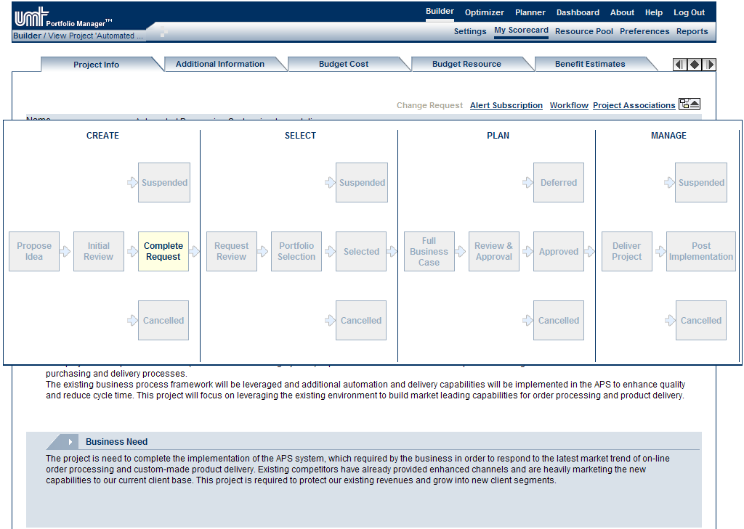
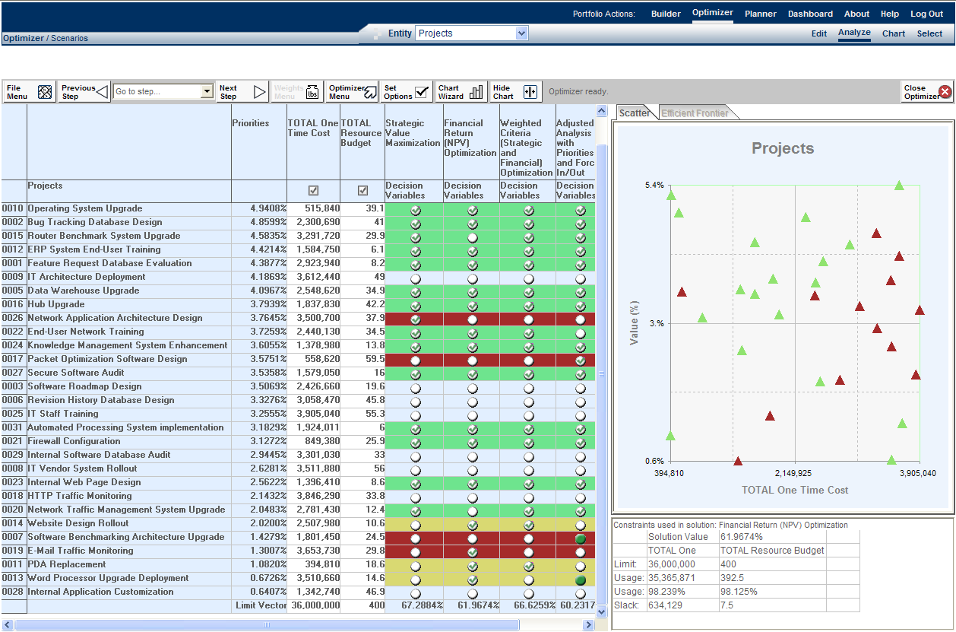
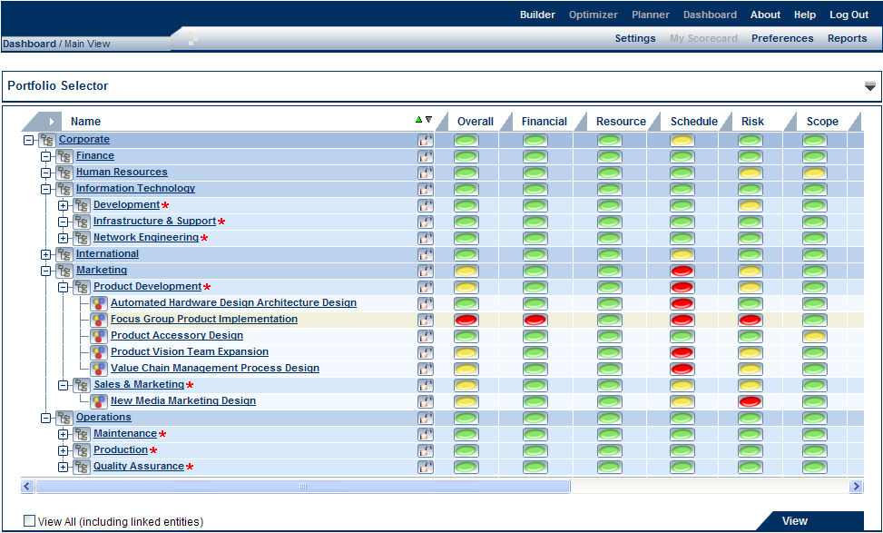









Enterprise Project Management Solution
The UMT Portfolio Manager 3.3 Server integrates with the Microsoft Office Project Server 2003 to provide organizations with an end-to-end Project & Portfolio Management solution
Portfolio Builder
Portfolio Optimizer
Portfolio Dashboard
Line of Business Systems
Notes:
© 2004 Microsoft Corporation. All rights reserved.
This presentation is for informational purposes only. Microsoft makes no warranties, express or implied, in this summary.

Slide 14
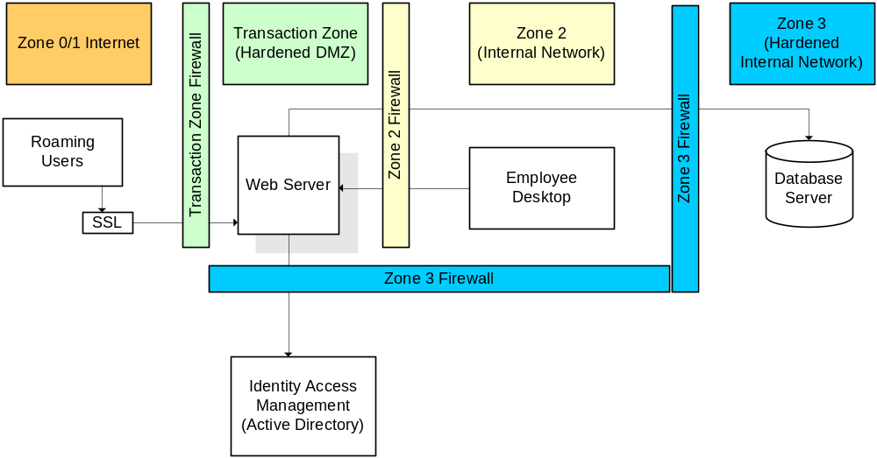
Logical Design
Notes:
This is a standard configuration…
Standard 3-tier ASP.NET application, developed mainly in Visual Studio, using C#. Client-side ActiveX controls are embedded.

Slide 15
Manage the Synergies Between PPM and APM
UMT Portfolio Manager 3.3 Server includes best practice portfolio analytical techniques to help organizations manage project, program, and application portfolios
Business Strategy
IT Strategy
Application
Valuation
Portfolio
Selection
Application
Redundancy
Assessment
Application
Portfolio
Management
Application
Transformation
Decisions
New Project Requests
Project
Capture &
Valuation
Project
Portfolio
Management
Portfolio
Planning
Application
Inventory
Update
Portfolio
Execution
New / Enhanced Applications
Notes:
© 2004 Microsoft Corporation. All rights reserved.
This presentation is for informational purposes only. Microsoft makes no warranties, express or implied, in this summary.
The above diagram shows the synergies between Project Portfolio Management and Application Portfolio Management.
Application Portfolio Management methodologies help organizations create an inventory of all legacy applications, rationalize the application portfolio to remove redundancies, and effectively manage the application portfolio.
Any changes to the application portfolio (such as enhancing an application or sun-setting an application), results in a transformation project.
The transformation projects are then managed via your organization’s Project Portfolio Management governance processes (that is, Create, Select, Plan, and Manage)
After successful completion of the project (such as building a new application), the application inventory should be automatically updated (for example, by adding the new application to the inventory).

Slide 16

Project Portfolio Management
Gov Phases:
Create
Select
Plan
Manage
Complete
Project
Request
Form
1st
Review
2nd
Review
Portfolio Prioritization
Detailed Planning
Portfolio Tracking
1
Strategic Value
1
Develop Project Plan
1
Change Request Mgt
2
Financial Value
2
Assign Named Resources
2
Status Reporting
PPM
Lifecycle Steps:
3
Risk Value
3
Define Inter-dependencies
3
Portfolio Re-Optimization
Business Case Development
1
Resource Requirements
Portfolio Optimization
Project Tracking
2
Cost Estimates
1
Charting Analysis
Final
Approval
Baseline
1
Project Tracking
3
Benefit Forecasts
2
Constraint Analysis
2
Resource Mgt
4
Strategic Alignment Assessment
3
Adv Portfolio Analytics
3
Time Reporting
Completed
5
Risk Assessment
Portfolio
Selection
4
Issues & Risk Mgt
6
Phase & Milestone Planning
5
Document Mgt
6
Team Collaboration
Microsoft EPM Solution:
Portfolio Builder
Portfolio Optimizer
Portfolio Dashboard
Notes:
© 2004 Microsoft Corporation. All rights reserved.
This presentation is for informational purposes only. Microsoft makes no warranties, express or implied, in this summary.

Slide 17
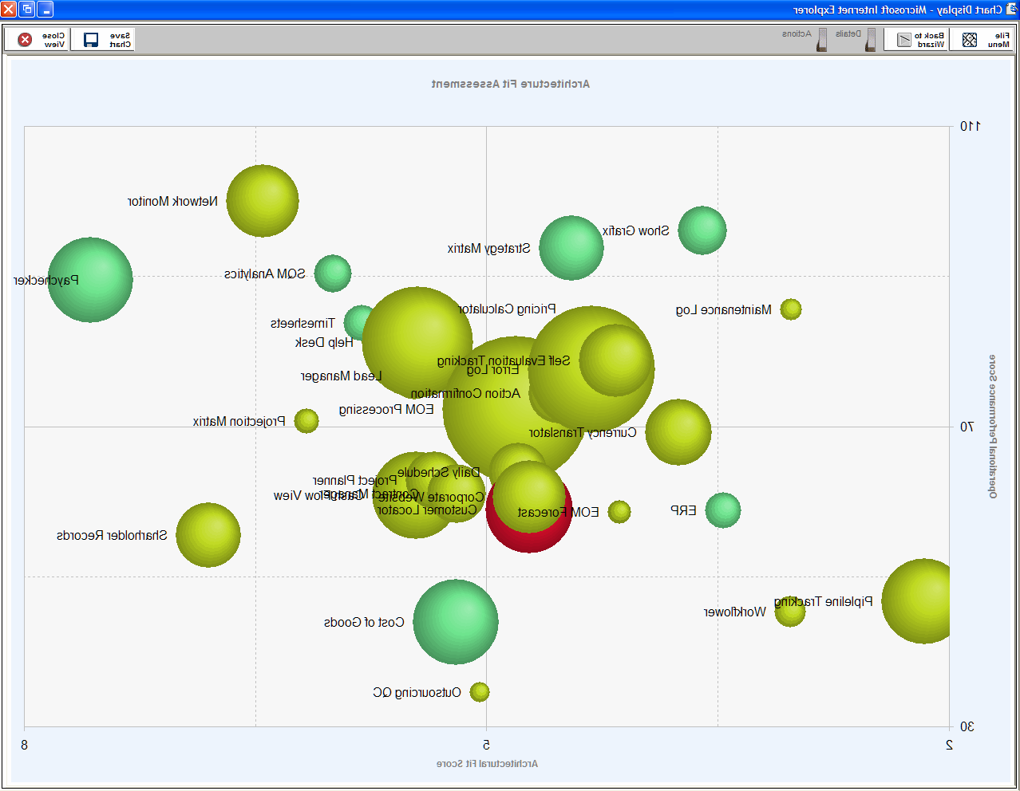
Application Portfolio Management
Gov Phases:
Create
Analyze
Manage
Derive Assessment Attributes
Manage Application
1
Business Importance
1
Status Reporting
Data Collection
2
Architectural Fit
2
Cost Management
PPM
Life Cycle Steps:
1
General Information
3
Risk
3
Document Management
2
TCO Estimates
4
Operational Performance
4
Enhancement Requests
3
Architectural Fit Assessment
4
Business Process Assessment
Portfolio Analysis
Portfolio Tracking
5
Risk Assessment
1
Redundancy Assessment
1
Transformation Roadmap
6
Operational Performance
Assessment
2
Charting Analysis
2
Cost Management
Manage Transformation
Projects via PPM
Governance Processes
Finalize Transformation
Decisions
Portfolio Builder
Portfolio Optimizer
Portfolio Dashboard
Microsoft EPM Solution:
Notes:
© 2004 Microsoft Corporation. All rights reserved.
This presentation is for informational purposes only. Microsoft makes no warranties, express or implied, in this summary.
The Office Project Portfolio Server 2007 helps organizations to manage their application portfolios. In the diagram above you can see the following governance phases and how the modules (of the Office Project Portfolio Server 2007) align with each Governance Phase:
Create (Supported by the Portfolio Builder): The Portfolio Builder allows organizations to create an inventory and standardize the data collection for all legacy applications.
Analyze (Supported by the Portfolio Optimizer): The Portfolio Optimizer helps organizations to derive assessment attributes, evaluate and finalize transformation decisions for the application portfolio.
Manage (Supported by the Portfolio Builder): Helps ensure organizations can track the ongoing performance of their application portfolios
(Note: Application transformation decisions (such as Maintain, Enhance, or Retire) result in project requests. These project requests are routed through an organization’s PPM governance processes (supported by Office Project Server 2007).

Slide 18
Configuration by Category / Entity
Configuration Settings
Common Settings | Project Configuration Settings | Program Configuration Settings | Application Configuration Settings
Account Definition Account Settings Organization Hierarchy Custom Portfolios User Management Business Driver Definition Resource Definition Project Server Gateway SharePoint Integration Organization Information Forms Custom Portfolio Information Forms My Scorecard Configuration Reports | Project Request Form Workflow Management Cost Management (Budget, Actual Forecast) Benefits Management Business Driver Impact Statements Risk Questionnaire Issues & Risk Log Status Tab Definition Change Management Documents Management Attribute Definition Indicator Definition Reports | Program Request Form Cost Management (Budget, Actual Forecast) Benefits Management Business Driver Impact Statements Risk Questionnaire Status Tab Definition Documents Management Attribute Definition Reports | Application Information Form Cost Management (Budget, Actual Forecast) Business Driver Impact Statements Architecture Drivers & Impact Statements Business Processes & Function Definition Risk Questionnaire Operational Performance Questionnaire Status Tab Definition Documents Management Attribute Definition Indicator Definition Reports

Slide 19
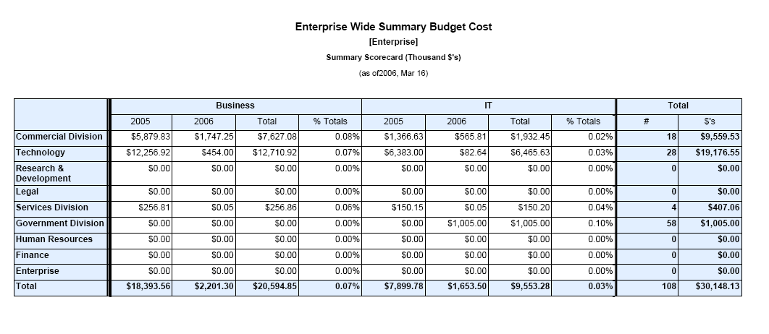
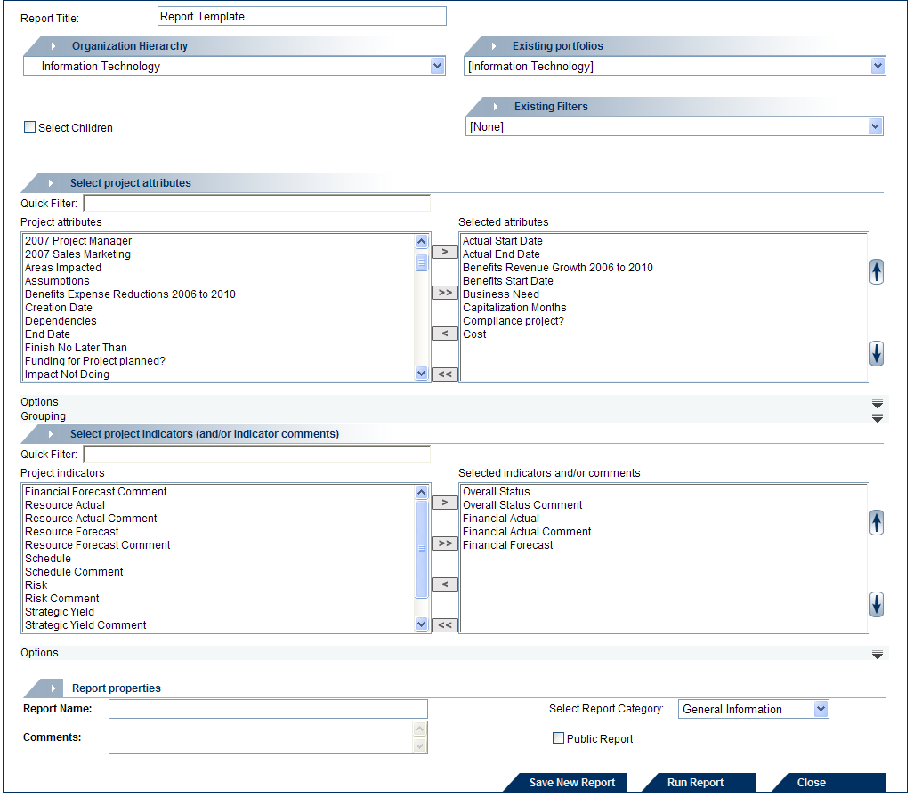
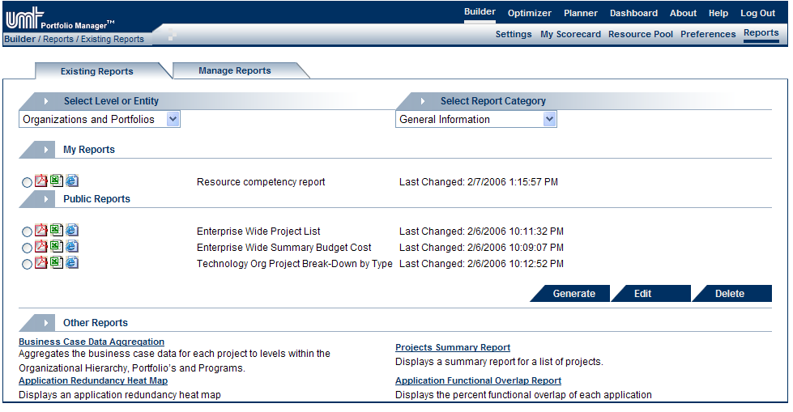
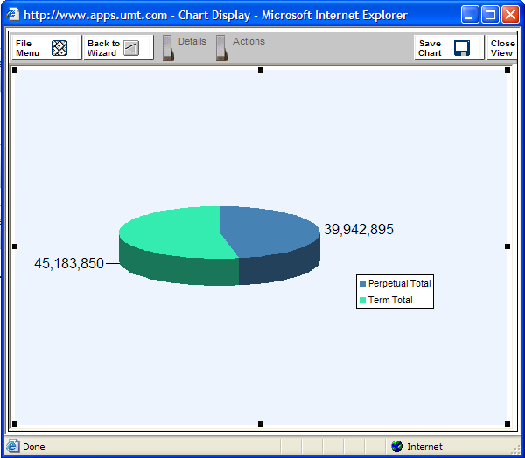
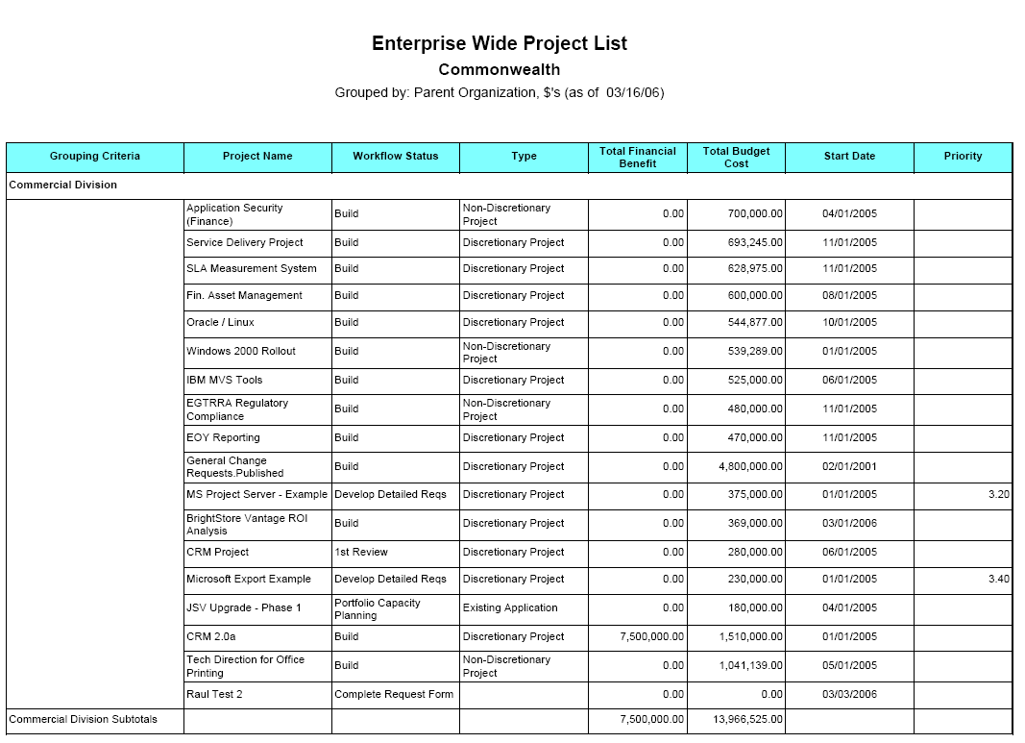
UMT Reporting Framework
Utilize intuitive generators to define and publish report templates to standardize and streamline the reporting process across the organization.
③
Generate Real-time Reports
①
Use Flexible Report Generators to Build Custom Templates
Real-time Report
②
Publish Templates to Report Library
Published Templates
Real-time Report
Flexible Report Generators
Powered by Microsoft SQL 2000 Reporting Services (SP2)
Real-time Report

Slide 20

Security, Extensibility & Interoperability
Authentication
  UMT Portfolio Manager 3.3 Server provides Windows Authentication, but does not sync with Active Directory
Public API
  UMT Portfolio Manager 3.3 Server does not currently provide a public API.
  A read-only API is scheduled for the Project Portfolio Server 2007 release
  The development team will be documenting the database schema to help partners and customer integrate with 3rd party solutions
  The UMT Portfolio Manager 3.3 Server includes a very flexible import module allowing organizations to import from a variety of 3rd party and home-grown solutions
  The UMT Portfolio Manager 3.3 Server includes an export module ensuring data can be shared with 3rd party reporting solutions

Slide 21
Project Server Gateway Overview
Installation & Configuration
Data Flow / Transfer
Project Server Gateway Demonstration

Slide 22
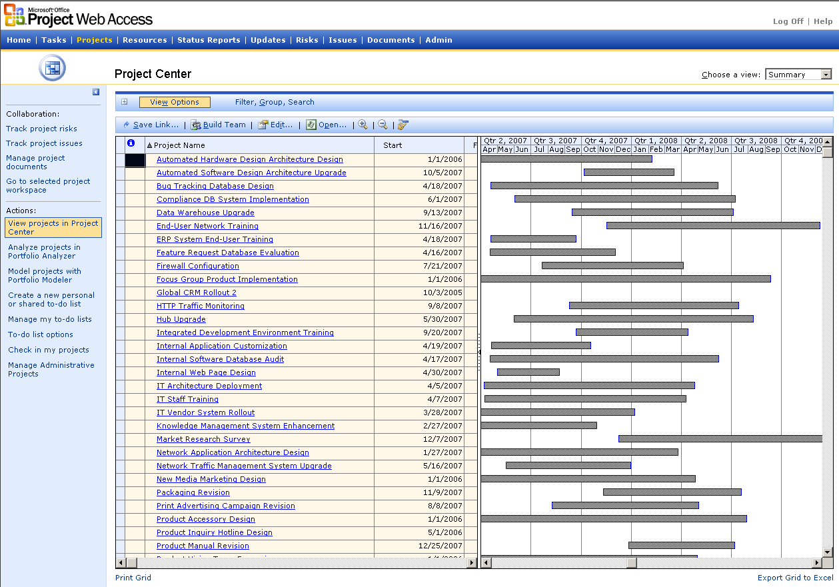
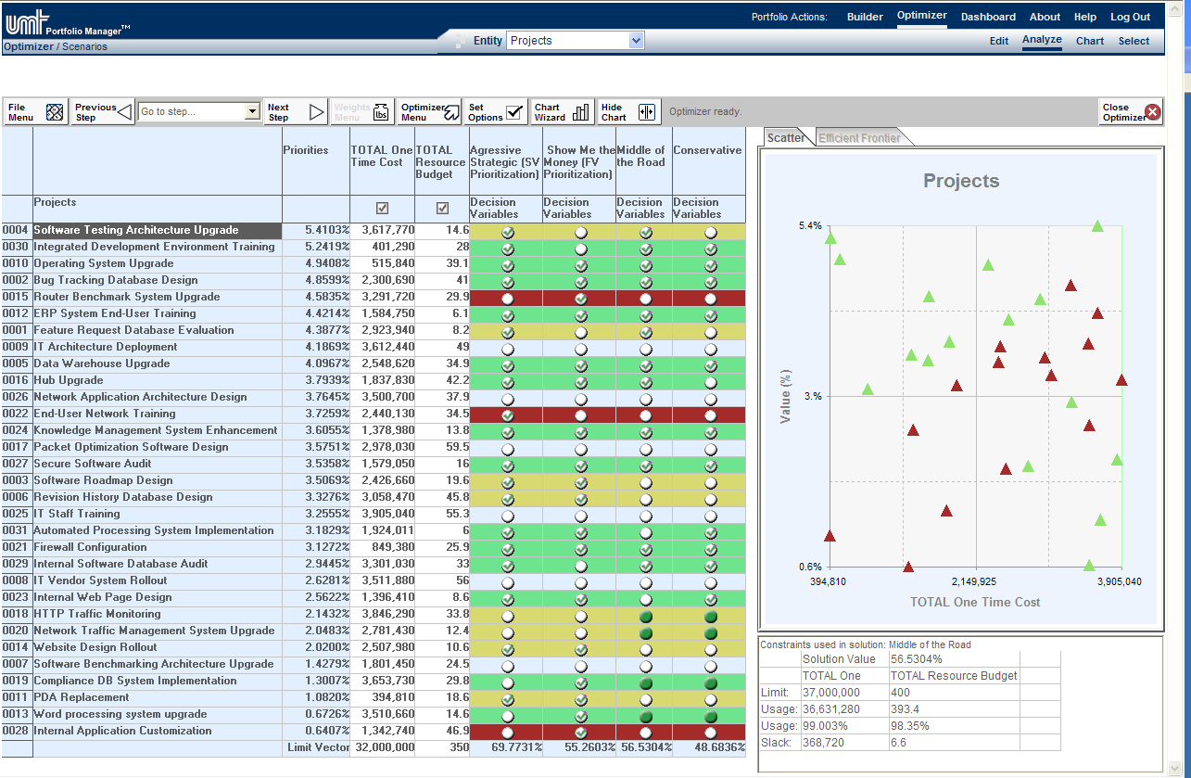
Project Server Gateway Overview
Project Server 2003
UMT Portfolio Manager 3.3 Server
Tight integration between UMT Portfolio Manager 3.3 Server and Office Project Server 2003 provides organizations with an end-to-end project portfolio management solution. UMT Portfolio Manager 3.3 Server is a key component within the Microsoft EPM Solution, providing the following benefits:
Helps ensure that customers and partners can quickly deploy world-class portfolio analytical techniques and tools within the EPM Solution.
Enables portfolio analysts to link federated computers running Office Project Server 2003 to UMT Portfolio Manager 3.3 Server and consolidate projects into an enterprise repository.
Provide organizations with a scalable end-to-end project portfolio management solution.

Slide 23

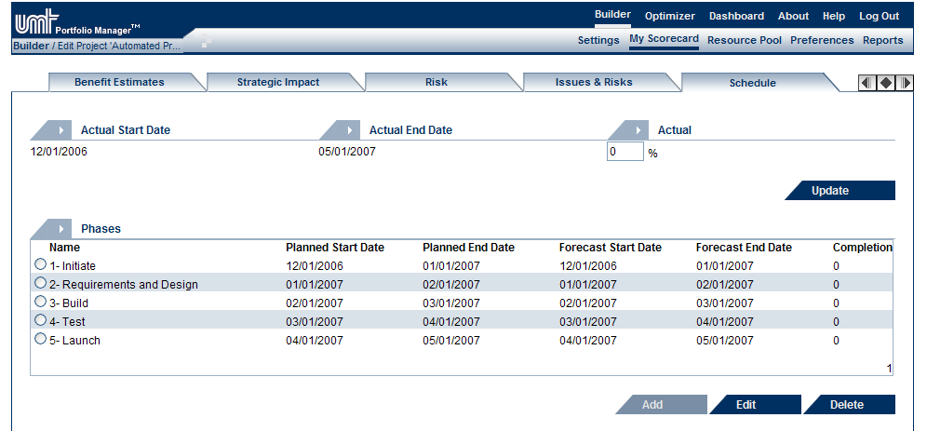

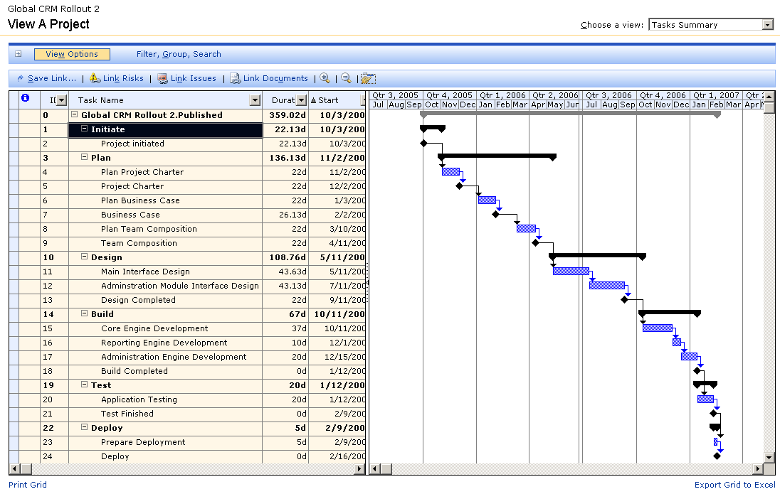
Data Elements Transferred
Schedule Management
Resource Management
Data Fields
Phase & Milestone Scheduling
Skills Management
Attributes
Budget
Budget
Forecast
Prioritization Scores
Earned Value
General Info
Actual
Forecast
Synchronize detailed task information in Project Server 2003 with the Phases and Milestones in UMT Portfolio Manager 3.3 Server
Actual
Aggregate named resource data from Project Server 2003 to the skill level in UMT Portfolio Manager 3.3 Server
Map and synchronize Enterprise Custom Fields in Project Server 2003 with Attributes in UMT Portfolio manager 3.3 Server
Detailed Project Scheduling
Named Resource Management
Enterprise Custom Fields
Budget
Budget
Forecast
Prioritization Scores
Earned Value
General Info
Actual
Forecast
Actual
Plan and track project schedules at the detailed task and milestone level.
Effectively manage the named resource availability and requirements across the organization
Create and manage Enterprise Fields in Project Server 2003

Slide 24
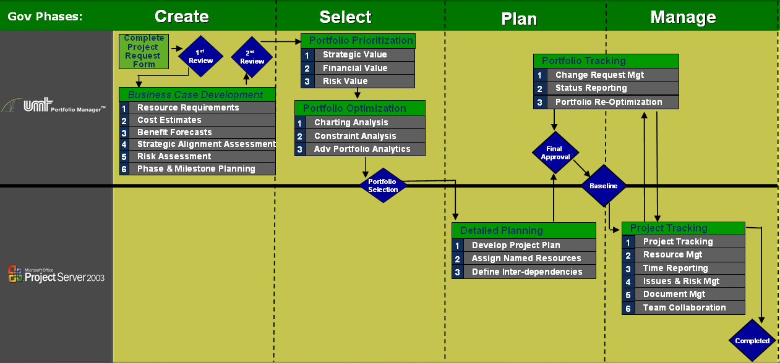

Project Server Gateway Workflow Example
Capture each project idea in Portfolio Manager 3.3 Server, develop a detailed business case and select the optimal project portfolio for the upcoming planning period
1
1
UMT Portfolio Manager 3.3 Server is often used as the central repository to capture all project ideas. Portfolio analytical techniques help executives to prioritize, optimize and select the optimal project portfolio that aligns with the organizations strategic priorities.
Once created in the Portfolio Server, a project plan can be automatically exported to the MS Project Server

Slide 25
Project Server Gateway Workflow Example
Export the selected project portfolio to Microsoft Project Server 2003 for detailed planning.
2
2
Using the Project Server Gateway analysts can automatically export the selected project portfolio to Microsoft Project Server 2003. The Project Managers are then responsible for creating detailed project plans before synchronizing the data with UMT Portfolio Manager 3.3 Server for final approval
Once created in the UMT Portfolio Manager 3.3 Server a project plan can be automatically exported to the MS Project Server 2003

Slide 26
Project Server Gateway Workflow Example
3
Synchronize project data from Microsoft Project Server 2003 with UMT Portfolio Manager 3.3 Server to effectively manage and track portfolio performance
3
The Project Server Gateway is used on a recurring basis to aggregate detailed project data (i.e. actual and forecast) from Project Server 2003 to UMT Portfolio Manager 3.3 Server.
Once linked data from the MS Project Server can be manually or automatically synchronized with UMT Portfolio Manager 3.3 Server.

Slide 27
Steps to Configure the Project Server Gateway
1. Install & Register the PDS Extender
Copy the PDSExtender.dll file, located in {installation path}\UMTSuite\MSPS, on the project server machine into the …\Project Server\BIN directory
Open a command prompt, go to the {installation path}\UMTSuite\MSPS directory. Run the following command:
  Regasm.exe "XXX\Project Server\Bin\PDSExtender.dll" /codebase
  where XXX is the full path to the copied PDSExtender.dll file in Project Server\Bin directory
In the same command prompt, execute
  RegisterMain PDSExtender.ExtenderMain
This should create a registry entry at HKEY_LOCAL_MACHINE/SOFTWARE/Microsoft/ Office/11.0/MS Project/WebClient Server/Project Server
  Name = PDSExtensionEx1
  Type = REG_SZ
  Data = PDSExtender.ExtenderMain
2. Configure Resource Outline Code
Select a Resource Outline Code to map named resources (in Project Server) with skills in UMT Portfolio Manager 3.3 Server
Add the appropriate skill types to the Resource Outline Code (e.g. Developer, Project Manager, Business Analyst etc.)
3. Update Global Resource Pool
Open Global Resource pool and map each named resource to the appropriate skill in UMT Portfolio Manager 3.3 Server (i.e. using the Resource Outline Code defined in the previous step)
4. Link Project Servers to UMT Portfolio Manager 3.3 Server
Using the Project Server Management setting, link multiple Project Servers to UMT Portfolio Manager 3.3 Server:
  General Settings
  Resource Pool & Availability Settings
  Link Resource Pools
5. Define Attribute Mapping Templates
Link Attributes in UMT Portfolio Manager 3.3 Server with Enterprise Custom Fields in Project Server 2003

Slide 28
Sales & Partner Readiness Update
Remaining Webcasts
Readiness Gantt
Product Documents & Resources
Product Training Courses

Slide 29
Sales & Partner Readiness Webcast Series
# | Title | Date
1 | Portfolio Management: UMT Portfolio Manager 3.3 Solution Overview | 03/28/2006
2 | The Synergies between Project & Portfolio Management | 04/25/2006
3 | UMT Portfolio Manager 3.3 Server Configuration | 05/17/2006
4 | Financial Services Case Study: Effective Portfolio Management | 06/6/2005
5 | Architecture & Project Server Gateway Overview | 06/27/2006
6 | Sales Strategies and Implementation Best Practices | 07/18/2006
7 | Best Practices in Application Portfolio Management (APM) | 08/09/2006

Slide 30
Sales & Partner Readiness Activities
Feb 06
Mar 06
Apr 06
May 06
Jun 06
Jul 06
Aug 06
Sept 06
Oct 06
UMT Bits
Build Sales Demo Database
Distribute Bits to PAC Partners
Build & distribute VPC of Sales Demo
Webcast Series
Deliver Sales & Partner Readiness Webcast Series
Early Adopter Partner Training
Tool & Best Practice Training available directly from UMT University (Public Courses)
Microsoft Sponsored Partner Training Course
PPS Preview Website Available
Create EPM University PPM Modules
5/23/2006
Sales Module
Envisioning Module
Planning Module
Implementation Module
Deliver EPM University PPM Courses
Sales & Implementation courses available through UMT CG
Envisioning and Planning Workshops available through QuantumPM
Server / CAL Model
UMT Portfolio Manager 3.3 Server
UMT Portfolio Manager 3.3 CAL
Project Portfolio Server
Project Portfolio CAL

Slide 31
Readiness Activities & Resources
Bits Distribution
UMT Portfolio Manager 3.3 Server VPC and associated resources
UMT Portfolio Manager 3.3 Server Evaluation Bits
(Note: A UMT Portfolio Manager 3.3 Server DVD Image is available for partners)
Sales & Partner Readiness Webcast Series
Microsoft and UMT Consulting Group are hosting a webcast series designed to provide the sales field and partners with the knowledge to effectively sell the UMT Portfolio Manager 3.3 Server to new and existing customers. Click on this link to view the webcast schedule and recordings.
UMT Portfolio Manager 3.3 Server Solution Overview
In response to the incredible interest from customers, Microsoft is hosting a recurring presentation to provide a comprehensive overview of the UMT Portfolio Manager 3.3 Server. Please join us every Thursday (March – June) at 8:30 – 9:30am (PST) to learn how this exciting solution can help organizations realize their potential by identifying, selecting, and delivering investments that best align with the business strategy. Click on this link for login details.
(Note: this recurring presentation will run until 06/27/2006)
Product Collateral
General resources (note: available for Microsoft FTE only)
Office 12 Preview Site: Microsoft Office Project Portfolio Server 2007)
Partner Portal

Slide 32
UMT Portfolio Manager 3.3 Server Training Courses
UMT Portfolio Manager 3.3 Server Sales Training
Overview:
Duration: 2 days
Trainers: UMT University – courses available from May 15th 2006
Contacts: To arrange a course contact odelucio@umt.com
Trainer Costs: $1,800 per day + expenses
(note: You can hire a UMT Trainer at the fixed rate above, but you will be responsible for the course logistics (e.g. Facility, Catering, Printing, Registration etc.))
UMT Portfolio Manager 3.3 Server Implementation Workshop
Overview:
Duration: 4 days
Trainers: UMT University – courses available from May 15th 2006
Contacts: To arrange a course contact odelucio@umt.com
Trainer Costs: $1,800 per day + expenses
(note: You can hire a UMT Trainer at the fixed rate above, but you will be responsible for the course logistics (e.g. Facility, Catering, Printing, Registration etc.))

Slide 33

Ben Chamberlain
Senior Product Manager
bchamber@microsoft.com

